Slide 1
A Novel approach for brain tumor prediction using hybrid model
PIP104 University Project-II
Review-2
Batch Number:
Roll Number | Student Name
20211COM0066 20211COM0085 | K.M.Madhushree Sakshi.S
20211COM0052 | Misbah Anum
20211COM0086 | Syeda Taskiya Fathima
20211COM0061 | Suhana Anjum
Under the Supervision of,
Assistant Prof. Mr. Arun Kumar S
School of Computer Science & Engineering
Presidency University

Slide 2
Introduction
1. Brain tumors are rare, with about 250,000 new cases annually.
2. Brain tumors are a leading cause of cancer-related deaths due to their aggressive nature.
3. Tumors are classified as benign (localized) or malignant (spreading).
4. Early detection and accurate classification are vital for improving survival rates.
5. Manual MRI diagnosis is challenging due to complex brain tissue structure.
6. Automated techniques using machine learning and deep learning are increasingly being explored.

Slide 3
Introduction
8. EfficientNet is used to improve performance and efficiency.
9. The project aims to develop a composite model combining CNN and EfficientNet.
10. This model focuses on recognition, segmentation, and classification of brain tumors.
11. The approach aims to reduce computational load while maintaining high accuracy.
12. It provides real-time diagnostic support for medical professionals.

Slide 4
Literature Review
1. Deep Learning in Tumor Classification: Deep learning, particularly CNNs and EfficientNet models, has significantly improved brain tumor detection, focusing on optimizing CNN scaling for better accuracy and reduced computational load.
2. EfficientNet and Feature Extraction: EfficientNet integrates advanced mechanisms like Global Attention and Efficient Channel Attention, enhancing feature extraction, interpretability, and accuracy.
3. Advanced Classification Techniques: Methods like K-means clustering, and transfer learning enable multi-class tumor classification, achieving up to 91-93% accuracy.
4. Improved Diagnostics and Patient Outcomes: Enhanced models using Grad-CAM visualization tackle challenges like tumor variability, improving interpretability, diagnostic accuracy, and patient care outcomes.

Slide 5
Proposed Method
Dataset: 3,260 T1-weighted contrast-enhanced MRI images of meningioma, glioma, and pituitary tumors, with normalization and data augmentation applied.
EfficientNet: Used for feature extraction, optimized through compound scaling for better performance.
CNN: Refines features from EfficientNet and generates initial class probabilities.
Performance: Outperforms individual models in tumor classification.
Clinical Impact: Enhances detection, localization, diagnosis, and treatment planning for brain tumors in clinical settings.

Slide 6
Objectives
1. Enhance Detection Accuracy: Improve the accuracy of tumor detection and classification in MRI scans by integrating EfficientNet and CNNs.
2. Optimize Model Efficiency: Utilize compound scaling in EfficientNet to balance depth, width, and resolution, reducing computational load while maintaining performance.
3.Integrate Attention Mechanisms: Incorporate attention mechanisms to focus on critical regions in MRI images, improving sensitivity and distinguishing healthy tissue from tumors.
4. Evaluate Performance Metrics: Assess model effectiveness using accuracy, ensuring robust performance in tumor classification.
5.Improve Clinical Utility: Demonstrate the model’s capability in accurately localizing tumors, aiding in diagnosis and treatment planning, thereby enhancing patient outcomes.
6. Support Real-time Applications: Develop a model that can be adapted for real-time clinical use, streamlining workflows in diagnostic radiology.

Slide 7
Methodology
1. Dataset: 3,260 T1-weighted MRI scans of meningioma, glioma, and pituitary tumors from three planes (sagittal, axial, coronal), split into training, validation, and test sets.
2. Preprocessing: Min-max normalization and data augmentation techniques (rotation, flipping, scaling) to improve model robustness.
3. Model Architecture: Hybrid model combining EfficientNet for feature extraction, CNN for processing features for classification.
4. Training: Categorical cross-entropy loss with optimizers (Adam/SGD), trained over multiple epochs with batch size monitoring.
5. Evaluation: Performance metrics (accuracy) and hyperparameter tuning, with visualization using confusion matrices and ROC curves.

Slide 8
Expected Outcomes
The model’s performance was calculated using formulas of accuracy.
Accuracy is key metrics for evaluating classification models. Accuracy measures the overall correctness of predictions,
Expected Outcomes:
- The Hybrid Model outperforms in accuracy.
- The CNN is strong in identifying positive cases but has some limitations.
EfficientNet excels in accuracy.
Overall, the hybrid model proves to be the most effective for brain tumor classification, highlighting its reliability for clinical use.

Slide 9
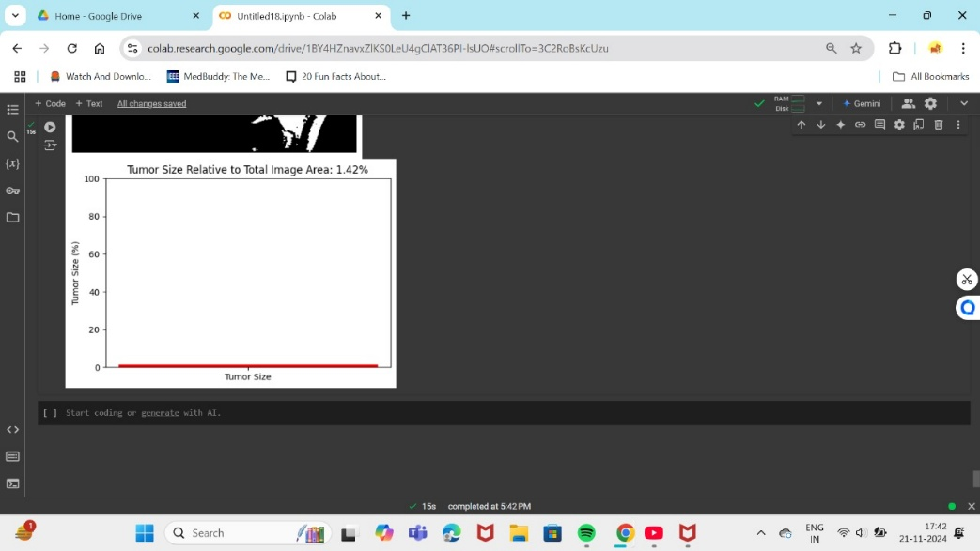
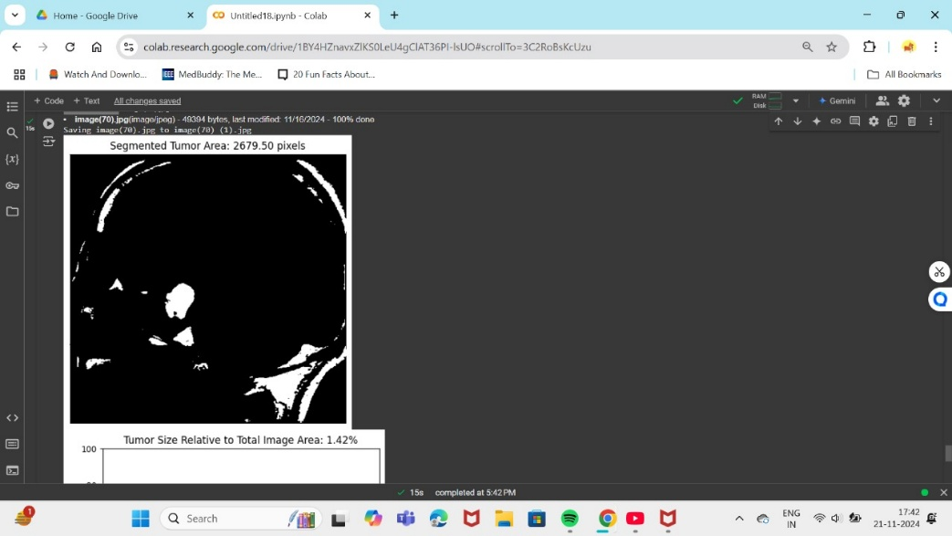
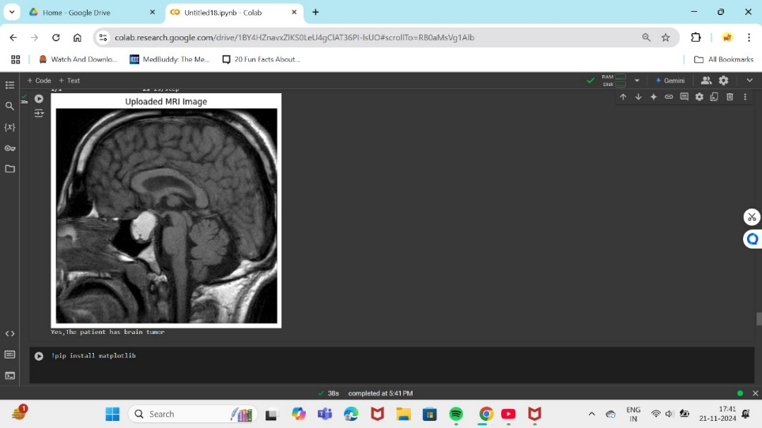
RESULT

Slide 10
Conclusion
1. Model Design: Combines EfficientNet, Convolutional Neural Networks (CNNs) to classify brain excrescences (meningioma, glioma, pituitary) from MRI images.
2. Preprocessing: Utilizes min-max normalization and data augmentation to enhance model robustness and generalization across different datasets.
3. Feature Extraction & Classification: EfficientNet is used for feature extraction, while CNN classification for improved processing and performance.
4. Evaluation: Model effectiveness assessed through accuracy,offering insights into classification capabilities.
5. Clinical Impact: High accuracy aids radiologists in early and precise brain excrescence detection, reducing reliance on manual analysis and supporting automated classification.

Slide 11
References
Aashutosh Kharb and Prachi Chaudhary , Designing efficient brain tumor classifier using hybrid EfficientNet-faster R-CNN deep learning model, September 2024.
Chetan Swarup, Kamred Udham Singh, Ankit Kumar,Saroj Kumar Pandey, Neeraj varshney and Teekam Singh, Brain tumor detection using CNN, AlexNet & GoogLeNet ensembling learning approaches, electronic research archive(2023).
Sushreeta Tripathy,Rishabh Singh , Mousim Ray ,Automation of Brain Tumor Identification using EfficientNet on Magnetic Resonance Images, ScienceDirect,2023.
Khaliki, M.Z., Başarslan, M.S. Brain tumor detection from images and comparison with transfer learning methods and 3-layer CNN. Sci Rep 14, 2664 (2024).
Dillip Ranjan, Nayak,Neelamadhab ,Padhy,Pradeep Kumar
,Mallick,Mikhail Zymbler and Sachin Kumar,Brain Tumor Classification Using Dense Efficient-Net,MDPI, 17 January 2022.
Tan, M., & Le, Q. , EfficientNet: Rethinking Model Scaling for Convolutional Neural Networks,Proceedings of the 36th International Conference on Machine Learning (ICML), PMLR,2019.
LeCun, Y., Bottou, L., Bengio, Y., & Haffner, P. , Gradient-Based Learning Applied to Document Recognition. Proceedings of the IEEE,1998

Slide 12
References
Cheng, J., Huang, W., Cao, S., Yang, R., Yang, W., Yun, Z., Wang, Z., & Feng, Q. , Enhanced Performance of Brain Tumor Classification via Tumor Region Augmentation and Partition. PLOS ONE,2015.
Shorten, C., & Khoshgoftaar, T. M, A Survey on Image Data Augmentation for Deep Learning. Journal of Big Data,2019.
Jayaraman, S., Esakkirajan, S., & Veerakumar, T, Digital Image Processing. Tata McGraw-Hill Education,2009.
Cortes, C., & Vapnik, V, Support-Vector Networks. Machine Learning,1995.
El-Dahshan ESA, Mohsen HM, Revett K, Salem ABM. Computer-aided diagnosis of human brain tumor through MRI: A survey and a new algorithm. Expert Syst Appl,2014.
Shenbagarajan Anantharajan, Shenbagalakshmi Gunasekaran, Thavasi Subramanian, Venkatesh R,MRI brain tumor detection using deep learning and machine learning approaches,2024.
Pacal, I., Celik, O., Bayram, B. et al. Enhancing EfficientNetv2 with global and efficient channel attention mechanisms for accurate MRI-Based brain tumor classification. Cluster Comput ,2024.
Md Manowarul Islam, Md. Alamin Talukder, Md Ashraf Uddin, Arnisha Akhter, Majdi Khalid,”BrainNet: Precision Brain Tumor Classification with Optimized EfficientNet Architecture”,wiley(2024).

Slide 13
Thank You

